Slide 1
Plasma cell Disorders
From MGUS to multiple myeloma
Vi Dao, MD, FRCPC
vdao@cancercare.mb.ca

Slide 2
Presenter Disclosure
Faculty: Vi Dao
Relationships with commercial interests: none

Slide 3
Mitigating Potential Bias
Not Applicable

Slide 4
Learning Objectives
Distinguish MGUS from multiple myeloma
Understand the overall prognosis and management of patients with multiple myeloma

Slide 5
Monoclonal Protein identified on SPEP or FLC
Are CRAB features present?**
C Ca²⁺ > 2.8
R renal :Creatinine > 177 or eGFR < 40 ml/min
A anemia: Hemoglobin less than 100 g/L
B bone: lytic bone lesions
**attributable to plasma disorder
Assess for CRAB features, order:
CBC
Creatinine
Ca²⁺
For IgM subtype, assess for lymphadenopathy and splenomegaly
yes
Refer to Hematology
No CRAB features
Are there any of the following features?
IgA or IgD monoclonal protein
Monoclonal protein > 15 g/L
Kappa or Lambda FLC > 100 mg/L
FLC ratio < 0.125 or > 8.0
yes
Order CT skeletal survey
(Omit if IgM subtype)
no
See MGUS follow-up algorithm

Slide 6
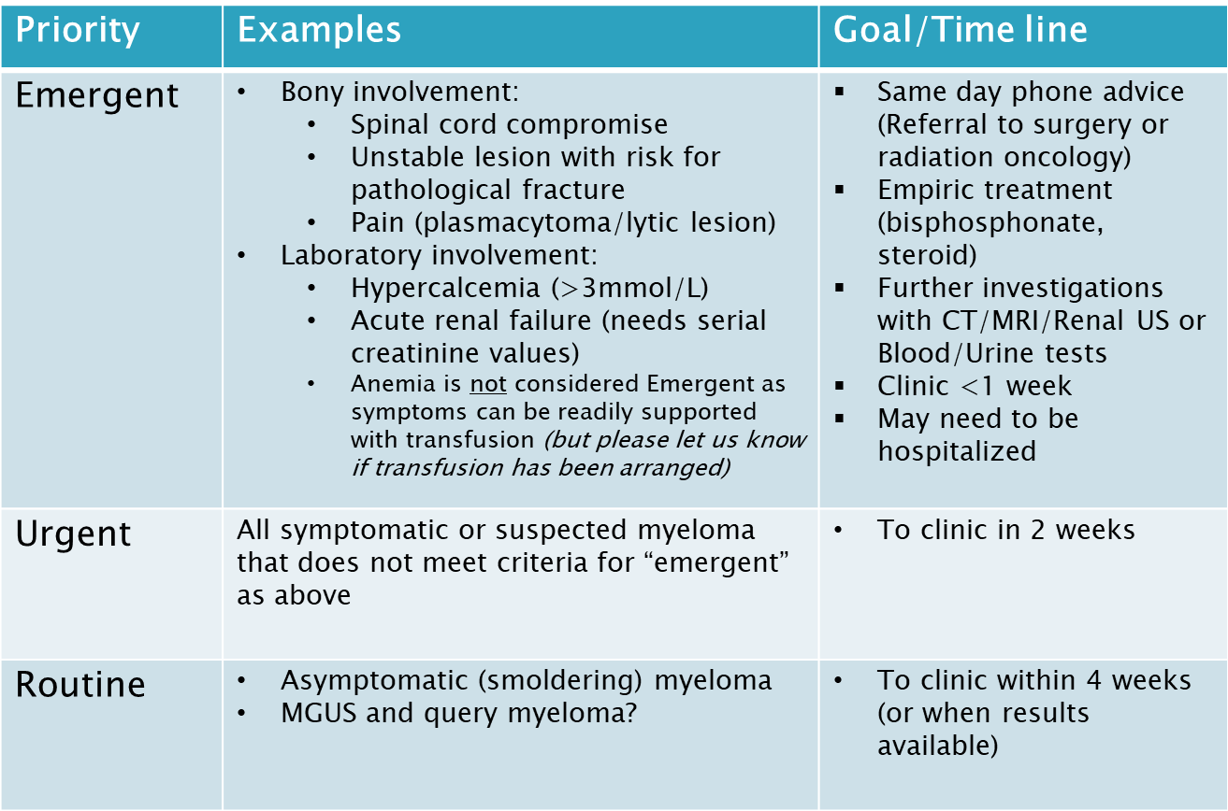

Slide 7
Monoclonal Protein identified on SPEP or FLC
Are CRAB features present?**
C Ca²⁺ > 2.8
R renal :Creatinine > 177 or eGFR < 40 ml/min
A anemia: Hemoglobin less than 100 g/L
B bone: lytic bone lesions
**attributable to plasma disorder
Assess for CRAB features, order:
CBC
Creatinine
Ca²⁺
For IgM subtype, assess for lymphadenopathy and splenomegaly
yes
Refer to Hematology
No CRAB features
Are there any of the following features?
IgA or IgD monoclonal protein
Monoclonal protein > 15 g/L
Kappa or Lambda FLC > 100 mg/L
FLC ratio < 0.125 or > 8.0
yes
Order CT skeletal survey
(Omit if IgM subtype)
no
See MGUS follow-up algorithm

Slide 8
MGUS is common
3% of general population >50 years old (increases with age)
~50% are low-risk
3 types of MGUS with variable risk of progression
1. IgM MGUS (15%)
2. Light chain MGUS
3. Non-IgM MGUS (80%)
Harms of testing?
~40% of patients with MGUS have anxiety, stress or fear related to diagnosis
Cost of follow-up – 100 million annually in the US alone

Slide 9
Disorders associated with M protein
Plasma cell disorders
B-cell disorders
Waldenstroms macroglobulinemia/lymphoplasmacytic lymphoma
Chronic lymphocytic leukemia (CLL)/small lymphocytic lymphoma (SLL)
Marginal zone lymphoma

Slide 10
Monoclonal Gammopathy of Undetermined Significance (MGUS) | Smoldering Multiple Myeloma | Multiple Myeloma
M protein in serum <30g/l and | M protein >30g/l and / or | Any level of M protein (none in non-secretory) and
Clonal Bone Marrow Plasma Cells <10% and | Clonal plasma cells >10% and | Clonal plasma cells >10% and
No myeloma related “CRAB” | No myeloma related “CRAB” | Myeloma related “CRAB”
No evidence of other B cell LPD or light chain associated Amyloidosis or other tissue damage |  | Or: “SLiM” criteria 1. BM plasma cells >60% 2. FLCR >100 or <0.01 3. >1 focal lesion on MRI
Rajkumar et al. 2014 Lancet Oncology; 15:e538-48

Slide 11
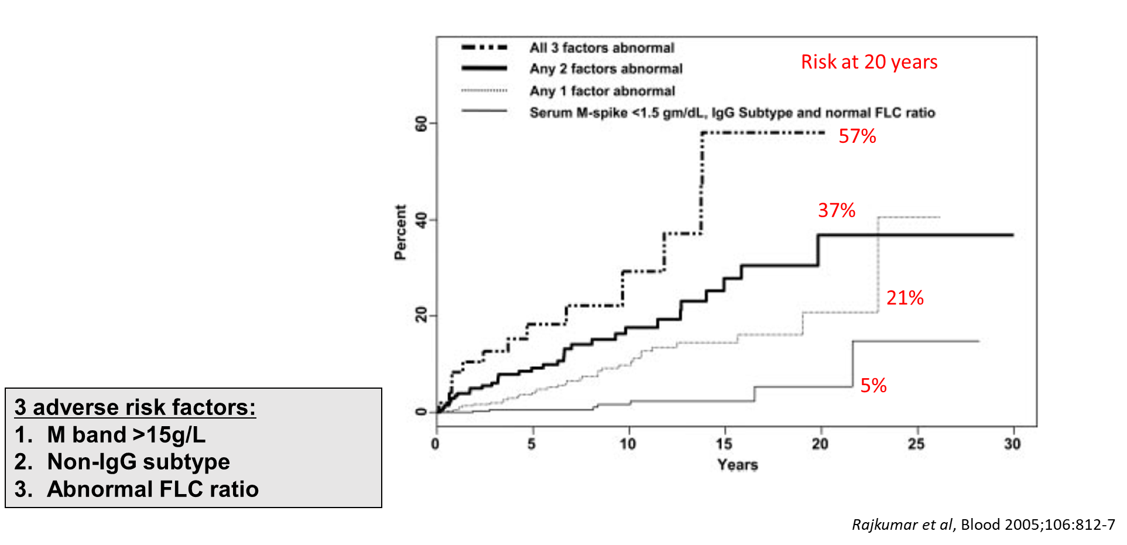
What does it mean to have MGUS?
3 adverse risk factors:
M band > 15 g/L
Non – IgG subtype (IgA, IgM, IgD)
Abnormal FLCI ratio (<0.26 or >1.65)

Slide 12
MGUS follow up
Repeat CBC, calcium, creatinine, SPEP, and FLC
in 6 months
Possible progression:
M-protein increase by 5 g/L
FLC increase by 100 mg/L
FLC ratio becomes < 0.125 or > 8
New onset CRAB features
Stable
Refer to Hematology
Repeat CBC, calcium, creatinine, SPEP, and FLC
annually

Slide 13
What is multiple myeloma?
1% of all cancers and 15% of hematologic malignancies
~2,700 new cases in Canada in 2015
(estimated 80 new cases per year in Manitoba)
Prevalence of ~7,500 across Canada
Median age at diagnosis of 69 years
Incurable malignancy characterized by multiple relapse
Risk factors: first degree relative with MM, nuclear radiation exposure, occupational exposure to petroleum and pesticides

Slide 15
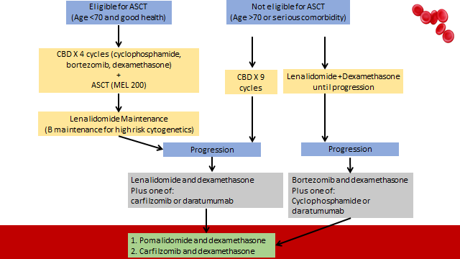
Treatment for multiple myeloma

Slide 16
Supportive care for patients with myeloma
Bone disease:
pain control (analgesia/radiation/surgical stabilization)
bisphosphonate (also treat hypercalcemia)
Renal insufficiency: avoid nephrotoxins, good hydration
Low counts (Hb, platelet) – transfusion support
Venous thromboembolism (ASA or LMWH or DOAC)
Infection: yearly influenza + consider recombinant VZV vaccine
Screening for:
Neuropathy
Hypothyroidism
Hyperglycemia
Secondary malignancies: skin, GI, hematologic, Gyne/GU, breast, lung, thyroid

Slide 17
Take home messages
MGUS and multiple myeloma are on the same spectrum of plasma cell disorders
Patients with MGUS can be monitored and do not require treatment unless progressive into multiple myeloma
Overall prognosis of multiple myeloma has improved but it is still an incurable malignancy that requires long term management

